Slide 1
Chapter 1 Introduction to Computers, Programs, and Java

Slide 2
Objectives
To write a simple Java program (§1.7).
To display output on the console (§1.7).
To explain the basic syntax of a Java program (§1.7).
To create, compile, and run Java programs (§1.8).
(GUI) To display output using the JOptionPane output dialog boxes (§1.9).

Slide 3
JDK Versions
JDK 1.02 (1995)
JDK 1.1 (1996)
JDK 1.2 (1998)
JDK 1.3 (2000)
JDK 1.4 (2002)
JDK 1.5 (2004) a. k. a. JDK 5 or Java 5
JDK 1.6 (2006) a. k. a. JDK 6 or Java 6
JDK 1.7 (possibly 2010) a. k. a. JDK 7 or Java 7

Slide 4
JDK Editions
Java Standard Edition (J2SE)
  J2SE can be used to develop client-side standalone applications or applets.
Java Enterprise Edition (J2EE)
  J2EE can be used to develop server-side applications such as Java servlets and Java ServerPages.
Java Micro Edition (J2ME).
  J2ME can be used to develop applications for mobile devices such as cell phones.
This book uses J2SE to introduce Java programming.

Slide 5
Popular Java IDEs
NetBeans Open Source by Sun
Eclipse Open Source by IBM

Slide 6
A Simple Java Program
Listing 1.1
//This program prints Welcome to Java!
public class Welcome {
public static void main(String[] args) {
System.out.println("Welcome to Java!");
}
}
Welcome
IMPORTANT NOTE: (1) To enable the buttons, you must download the entire slide file slide.zip and unzip the files into a directory (e.g., c:\slide) . (2) You must have installed JDK and set JDK’s bin directory in your environment path (e.g., c:\Program Files\java\jdk1.6.0_14\bin in your environment path.
Run

Slide 7

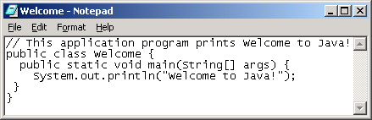
Creating and Editing Using NotePad
To use NotePad, type
  notepad Welcome.java
from the DOS prompt.

Slide 8

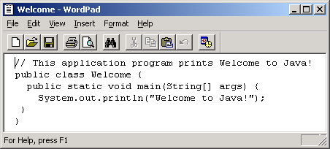
Creating and Editing Using WordPad
To use WordPad, type
  write Welcome.java
from the DOS prompt.

Slide 9
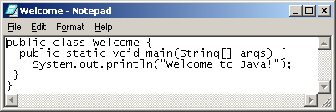
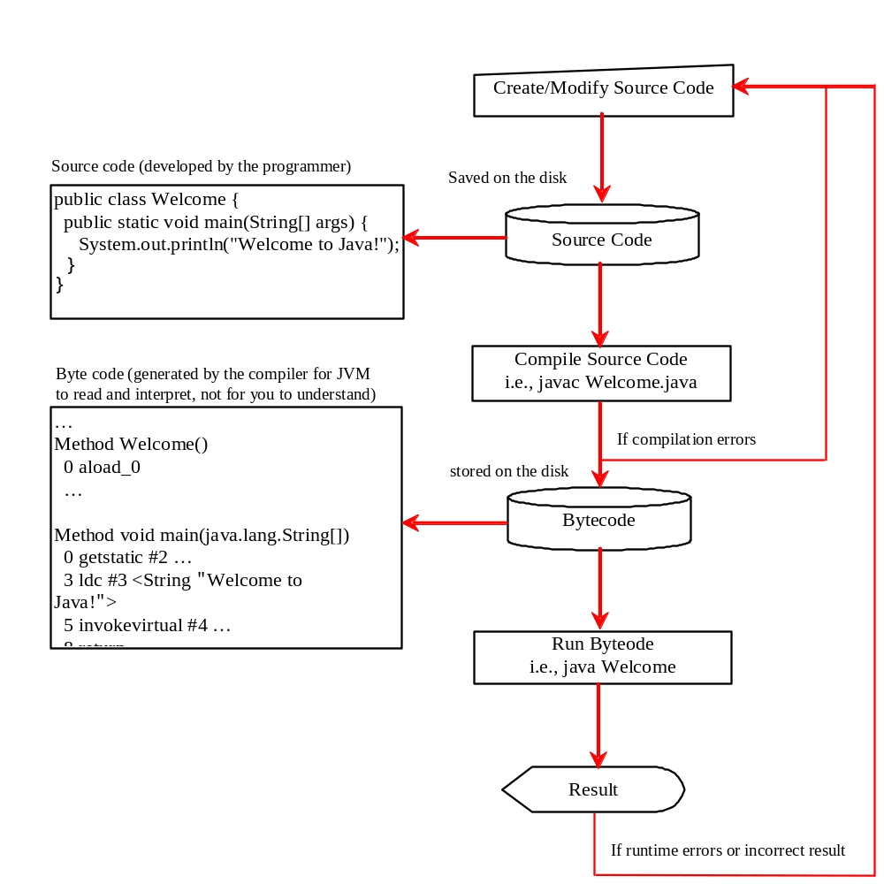
Creating, Compiling, and Running Programs

Slide 10
Trace a Program Execution
animation
Enter main method
//This program prints Welcome to Java!
public class Welcome {
public static void main(String[] args) {
System.out.println("Welcome to Java!");
}
}

Slide 11
Trace a Program Execution
animation
Execute statement
//This program prints Welcome to Java!
public class Welcome {
public static void main(String[] args) {
System.out.println("Welcome to Java!");
}
}

Slide 12

Trace a Program Execution
animation
//This program prints Welcome to Java!
public class Welcome {
public static void main(String[] args) {
System.out.println("Welcome to Java!");
}
}
print a message to the console

Slide 13
Two More Simple Examples
Welcome1
Run
ComputeExpression
Run

Slide 14
Supplements on the Companion Website
Companion Website
See Supplement I.B for installing and configuring JDK
See Supplement I.C for compiling and running Java from the command window for details
www.cs.armstrong.edu/liang/intro8e

Slide 15

Compiling and Running Java from the Command Window
Companion Website
Set path to JDK bin directory
  set path=c:\Program Files\java\jdk1.6.0\bin
Set classpath to include the current directory
  set classpath=.
Compile
  javac Welcome.java
Run
  java Welcome

Slide 16

Compiling and Running Java from TextPad
Companion Website
See Supplement II.A on the Website for details

Slide 17
Compiling and Running Java from NetBeans
Companion Website
See Supplement I.D on the Website for details

Slide 18
Anatomy of a Java Program
Comments
Reserved words
Modifiers
Statements
Blocks
Classes
Methods
The main method

Slide 19
Comments
Three types of comments in Java.
Line comment: A line comment is preceded by two slashes (//) in a line.
Paragraph comment: A paragraph comment is enclosed between /* and */ in one or multiple lines.
javadoc comment: javadoc comments begin with /** and end with */. They are used for documenting classes, data, and methods. They can be extracted into an HTML file using JDK's javadoc command.

Slide 20
Reserved Words
Reserved words or keywords are words that have a specific meaning to the compiler and cannot be used for other purposes in the program. For example, when the compiler sees the word class, it understands that the word after class is the name for the class. Other reserved words in Listing 1.1 are public, static, and void. Their use will be introduced later in the book.

Slide 21
Modifiers
Java uses certain reserved words called modifiers that specify the properties of the data, methods, and classes and how they can be used. Examples of modifiers are public and static. Other modifiers are private, final, abstract, and protected. A public datum, method, or class can be accessed by other programs. A private datum or method cannot be accessed by other programs. Modifiers are discussed in Chapter 6, “Objects and Classes.”

Slide 22
Statements
A statement represents an action or a sequence of actions. The statement System.out.println("Welcome to Java!") in the program in Listing 1.1 is a statement to display the greeting "Welcome to Java!" Every statement in Java ends with a semicolon (;).

Slide 23

Blocks
A pair of braces in a program forms a block that groups components of a program.

Slide 24
Classes
The class is the essential Java construct. A class is a template or blueprint for objects. To program in Java, you must understand classes and be able to write and use them. The mystery of the class will continue to be unveiled throughout this book. For now, though, understand that a program is defined by using one or more classes.

Slide 25
Methods
What is System.out.println? It is a method: a collection of statements that performs a sequence of operations to display a message on the console. It can be used even without fully understanding the details of how it works. It is used by invoking a statement with a string argument. The string argument is enclosed within parentheses. In this case, the argument is "Welcome to Java!" You can call the same println method with a different argument to print a different message.

Slide 26
main Method
The main method provides the control of program flow. The Java interpreter executes the application by invoking the main method.
The main method looks like this:
public static void main(String[] args) {
// Statements;
}

Slide 27
Displaying Text in a Message Dialog Box
you can use the showMessageDialog method in the JOptionPane class. JOptionPane is one of the many predefined classes in the Java system, which can be reused rather than “reinventing the wheel.”
WelcomeInMessageDialogBox
Run
IMPORTANT NOTE: To enable the buttons, you must download the entire slide file slide.zip and unzip the files into a directory (e.g., c:\slide) .

Slide 28
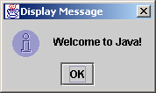
The showMessageDialog Method
JOptionPane.showMessageDialog(null,
"Welcome to Java!",
"Display Message",
JOptionPane.INFORMATION_MESSAGE);

Slide 29
Two Ways to Invoke the Method
There are several ways to use the showMessageDialog method. For the time being, all you need to know are two ways to invoke it.
One is to use a statement as shown in the example:
  JOptionPane.showMessageDialog(null, x,
  y, JOptionPane.INFORMATION_MESSAGE);
where x is a string for the text to be displayed, and y is a string for the title of the message dialog box.
The other is to use a statement like this:
  JOptionPane.showMessageDialog(null, x);
where x is a string for the text to be displayed.

